Slide 1


Problem Solving with the Internet of Things and Python
Unit 4 - BLE Connectivity
Notes:
Note from Doug. If you are using these materials, you can remove the CWRU logo and replace it with your own, but please retain the CC-BY logo on the first page as well as retain the acknowledgements page(s).

Slide 2
Lab 7
Explore more BLE

Slide 3
Explore more BLE
Let’s investigate two more big areas to consider with Iot development:
BLE Power Consumption
and
BLE Security

Slide 4

BLE Power Consumption

Slide 5
Power Consumption
Although most of our lab work will be completed with the IoT device “plugged in” to a power source, eventually our IoT device may end up being battery powered in the field.
Since the BLE radio communications will be the largest source of power draw, we should always try to keep the possible ways to reduce power consumption in mind.

Slide 6
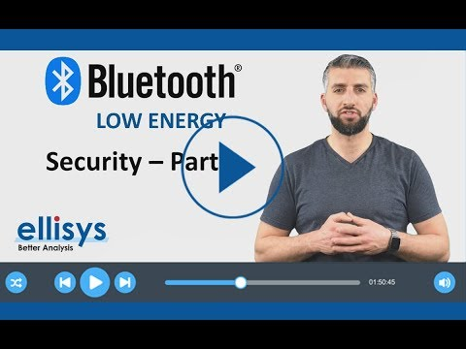
BLE Security

Slide 7
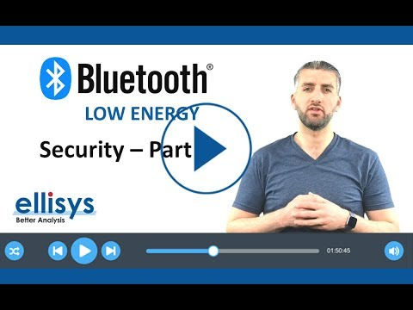
BLE Security - Part 2

Slide 8
What about the Feather Sense?
The chip on the Feather Sense is a Nordic nRF52840 which is BLE 5.3 compliant.
Read more about it HERE.
While we will not explore BLE security in detail in the labs, it is good to know that our choice of processor has the ability to implement all the latest greatest BLE security options.

Slide 9
Lab 6 → Lab 7
In Lab 6 you were introduced to BLE communication and you used some predefined “Packet” types. You used both a ButtonPacket object and a ColorPacket object. These were both provided by Adafruit and made it pretty easy to communicate with the Adafruit Bluefruit LE Connect App using the UART service.
In Lab 7 you will again use the UART service, but you will not use predefined objects for communication. Instead you will create your own custom commands.

Slide 10
Lab 7 - parts 2,3,4 and 5
In parts 2,3,4 and 5 you will explore connecting the Feather Sense to a computer.

Slide 11
More resources
https://learn.adafruit.com/alltheiot-transports/bluetooth-btle
https://www.popsci.com/reviews/how-does-bluetooth-work/
Complete BLE video series
Optimizing BLE power consumption
BLE Security Guide

